Slide 1
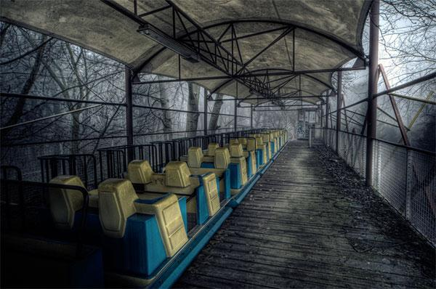
Will you survive?
Zombie Adventure Park
~ 3 dwarfs

Slide 2
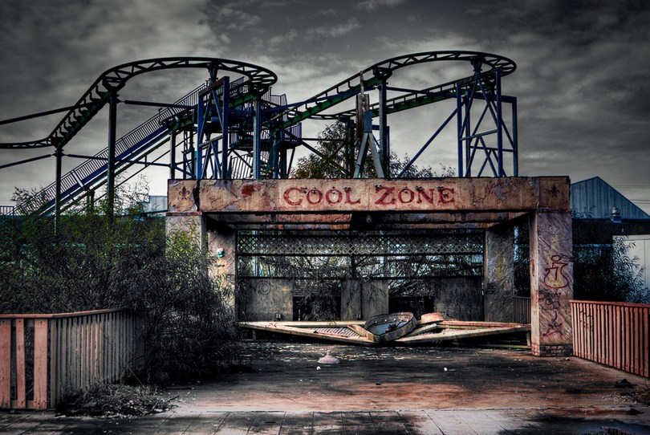
Defeat the zombies to save your wife

Slide 3
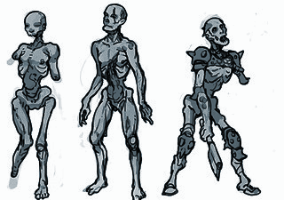

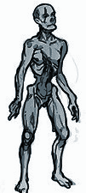

Be sure to kill all zombies before they can hurt you

